Slide 1
Project p2, filmpjes want funny
Made by best edtri vre Jmse ed ereb

Slide 2

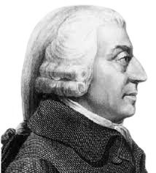


Greetings my child. I am the great Adam Smith, God of capitalism. And I have created you for the purpose of becoming as great as I once was. Now tell me child, what name would you like to have?

Slide 3
Pick name
Make Name so u can get score on score board
Make submit button that reads out: Finalise name.

Slide 4
Welcome back my child, and what a wonderful name you have chosen. Now hurry and go to earth. Here you will start your journey conquering platens until you reach the gates of heaven once more.

Slide 5
Earth
Click, hire, manage, research, rocket
Earn cash
Buy and board rocket

Slide 6
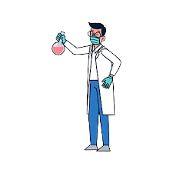

I have done it, after much research I have made a rocket, now we just need the funds, and then you can go on your planet conquering journey. Good luck boss!

Slide 7



Slide 8
On moon
mine, hire miners, manage, research
Mine moon cheese
Find the Moon cheese armor

Slide 9

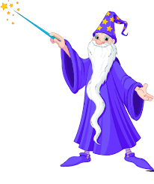
I have done it, after much research I have found the location of the moon cheeze after that u can go to the sun and find the elder phoenix feather.
e

Slide 10


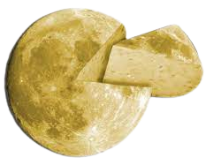

Slide 11
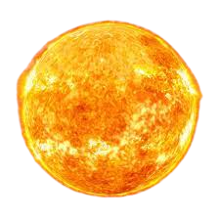

Slide 12
The unmatched power of the sun
hunt, hire hunters, manage, research
Hunt phoenixes
Seek the elder phoenix feather

Slide 13




Slide 14
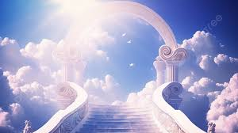
Welcome back once more my child. I am happy with what you have become. Your progress has graced you with the title of demi-god of capitalism.

Slide 15
The end
Display Name
score

